Slide 1
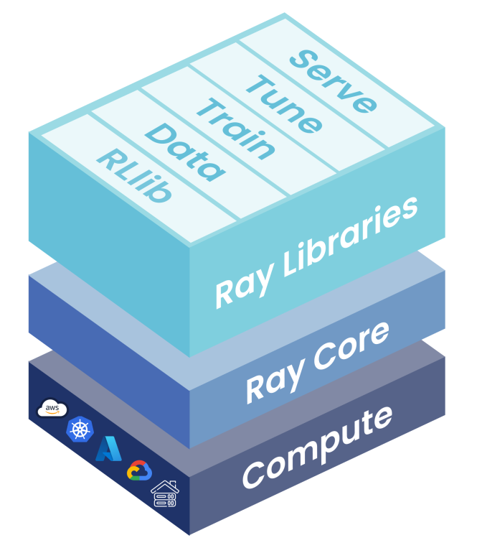
Ray
https://bit.ly/RAY123

